Slide 1
Tremors Proposal
Team 2 - Anthony Calvo, Linda Gong, Jake Miller, Mike Sander

Slide 2

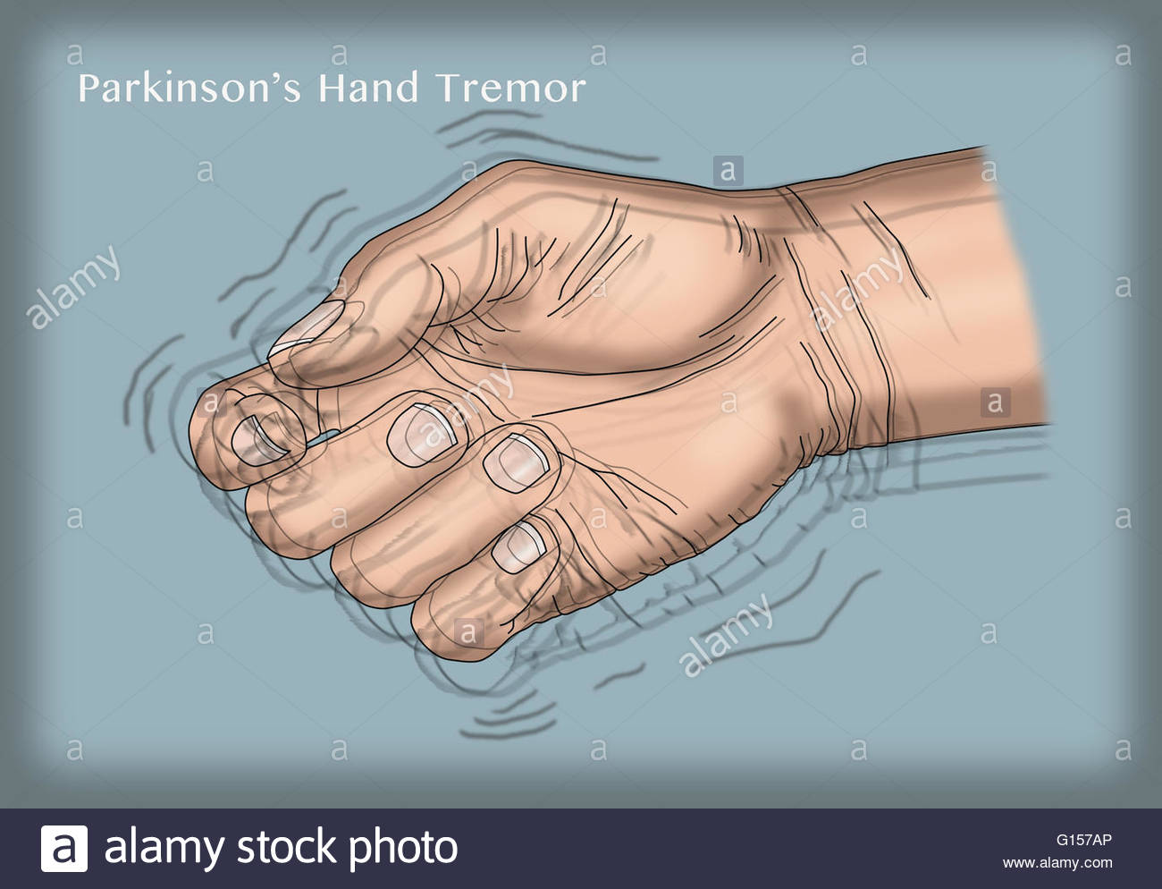
Introduction - Parkinson’s

Slide 3
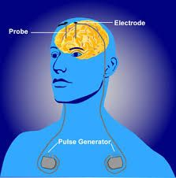
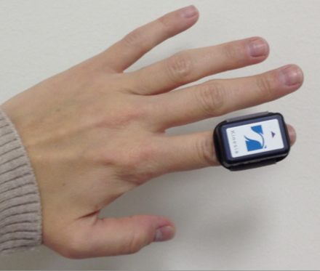
Problem Description
Tremors make daily tasks difficult
Current solutions are not satisfactory
  Treatment not integrated with monitoring
  Invasive
  Not suitable for daily use (not easily portable)
  Data is collected sparingly
  Minimizes recalibration

Slide 4
Proposed Solution
Bracelet to wear in day-to-day life
Contains accelerometer to measure tremors
Communicate with GUI and tremor control electronics
GUI allows user to visualize and monitor tremors
TCE controls feedback to mitigate tremors
  Our idea: utilize Electric Muscle Stimulator (EMS)
  Need to check if feasible

Slide 5
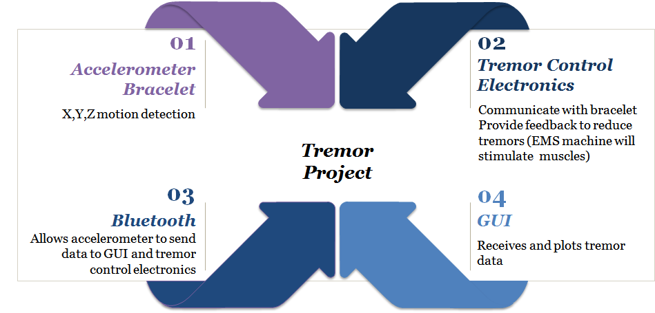
Demonstrated Features

Slide 6
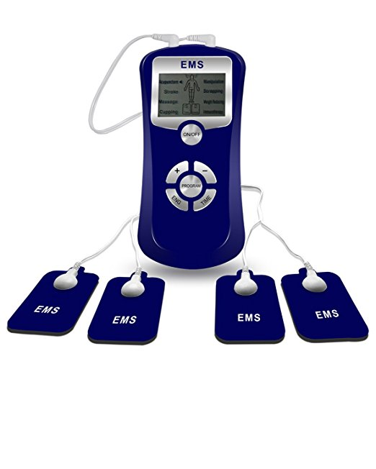
Available Technologies
Accelerometer chips that measure acceleration in x,y, and z are readily available and inexpensive.
A PIC32 microcontroller will be used to collect data from the accelerometer and communicate it to a Bluetooth chip.
A Bluetooth chip will communicate the data from the PIC to the computer program.
An Electric Muscle Stimulator (EMS) causes contractions in hand muscles via electrodes attached to the arm.

Slide 7
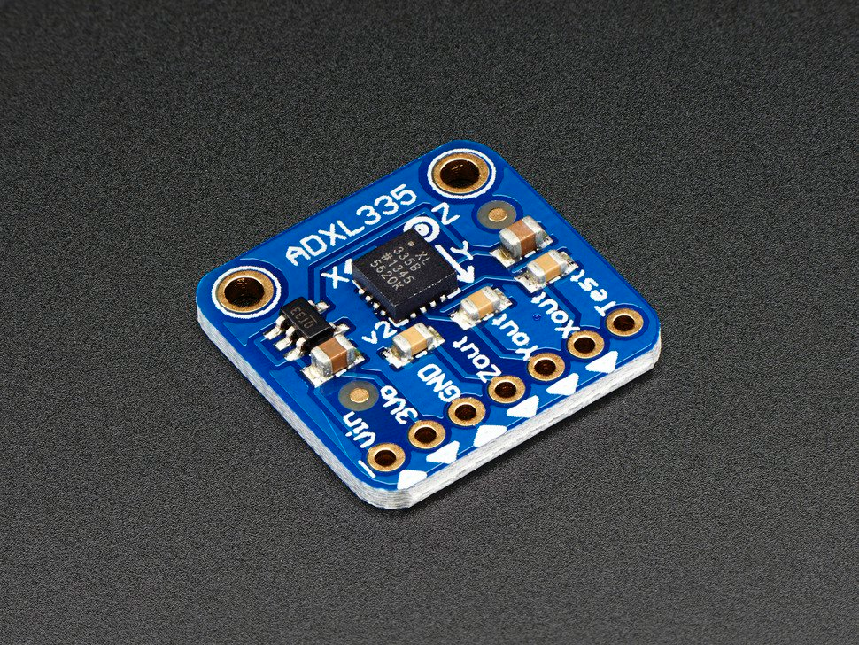

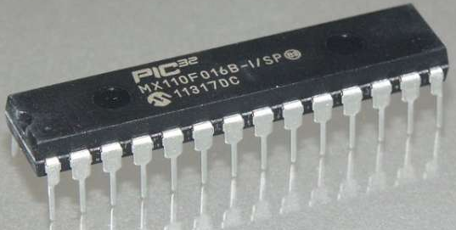
Engineering Content
Hardware Design (PCB)
  Accelerometer
  PIC 32 microcontroller
  Bluetooth Module
Programming
  GUI
  Bluetooth communication
  Analysis of tremor data
Signal Processing
  Distinguish between voluntary movements and tremors
Feedback to Combat Tremors
  Feedback network between EMS machine and bracelet
  Vary strength and frequency of the EMS output to reduce tremor severity

Slide 8
Conclusions
End result: A closed-loop system that monitors and reduces tremors of a Parkinson’s patient.
Addresses issues with current treatments
  Suitable for daily use
  Non-invasive
  Constant data collection
Need to confirm that EMS will perform as expected

Slide 9


References
http://www.pdf.org/parkinson_statistics
http://www.parkinson.org/understanding-parkinsons/what-is-parkinsons
http://www.microchip.com/design-centers/32-bit/architecture/pic32mx-family
http://www.analog.com/en/products/mems/accelerometers/adxl345.html#product-overview
https://www.adafruit.com/product/163
https://www.sparkfun.com/products/10937
https://www.adafruit.com/product/2995
https://www.amazon.com/Santamedical-Channel-Electrotherapy-Relief-Device/dp/B01GIKYYVG/ref=sr_1_8_a_it?ie=UTF8&qid=1509308445&sr=8-8&keywords=ems+machine
http://www.mayoclinic.org/diseases-conditions/parkinsons-disease/basics/treatment/con-20028488
https://www.ncbi.nlm.nih.gov/pmc/articles/PMC3367543/
PowerDot EMS machine: https://www.powerdot.com/products/powerdot-muscle-stimulator
https://www.digikey.com/en/articles/techzone/2012/oct/what-you-need-to-know-about-vibration-sensors

